Slide 1
SMART TAXI SERVICE TEAM: GROUP 14
Meghana Santosh Kumar
Praveen Kumar Elagudri
Preethi Srinivasan
Sandesh Airody Alse

Slide 2
Contents
■ Introduction
■ Component Overview
Mobile Sensor Cloud Infrastructure
■ Mobile Sensor Cloud Components
■ Mobile Sensor Cloud Provisioning
■ Monitoring of resources
■ Repository Management
■ Traffic Load Generator, Load Balance and Scalability
■ Billing for sensing and data services
■ User Dashboard and Analytics

Slide 3
Introduction
Traffic incidents in United States happen on annual basis of upwards of 33000 incidents .
Leading cause of these accidents are driver distractions.
Human driven cars come at a very high cost in terms of danger.
The U.S. Department of Transportation actually assigns a value to each human life: $9.2 million.
Self Driving Cars ?

Slide 4
Continued
In order for the cars to operate most efficiently, they'd need to communicate with one another, helping to identify traffic problems or road risks early on.
Driverless cars sense their surroundings using technology such as temperature sensors,speed sensors,lidar sensors, GPS, and computer vision.
Using sensors we can monitor various aspects of the vehicle.

Slide 5
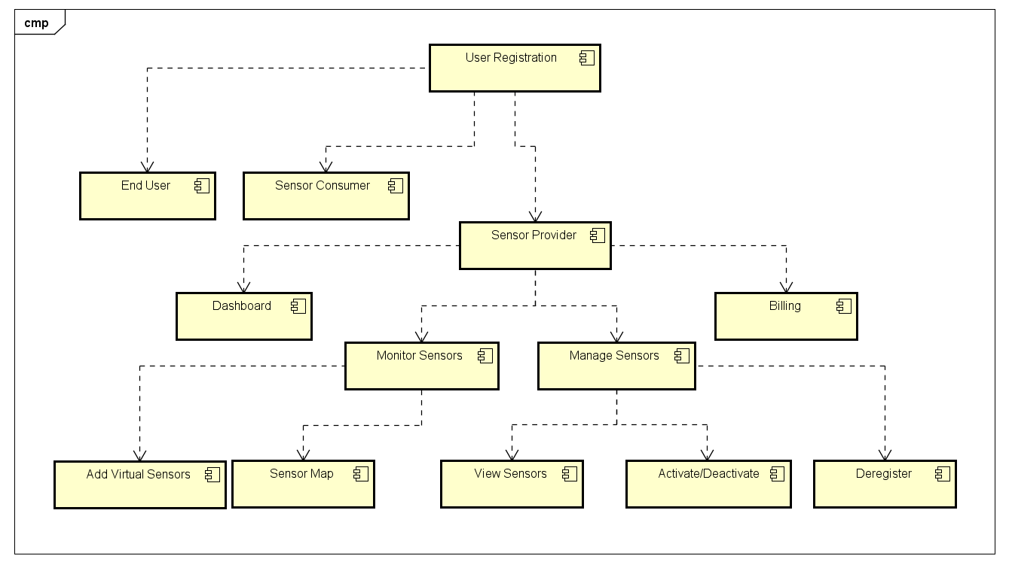
Component Overview
The registered users can be end user , a sensor consumer or sensor provider

Slide 6
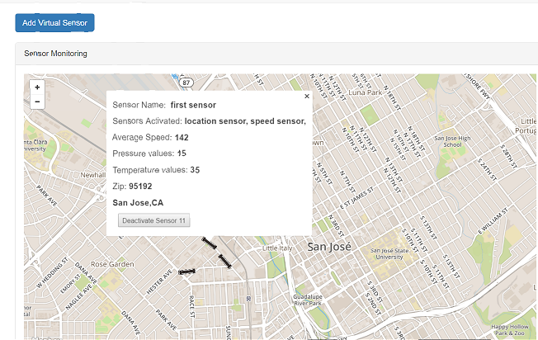
Monitoring Sensors

Slide 7
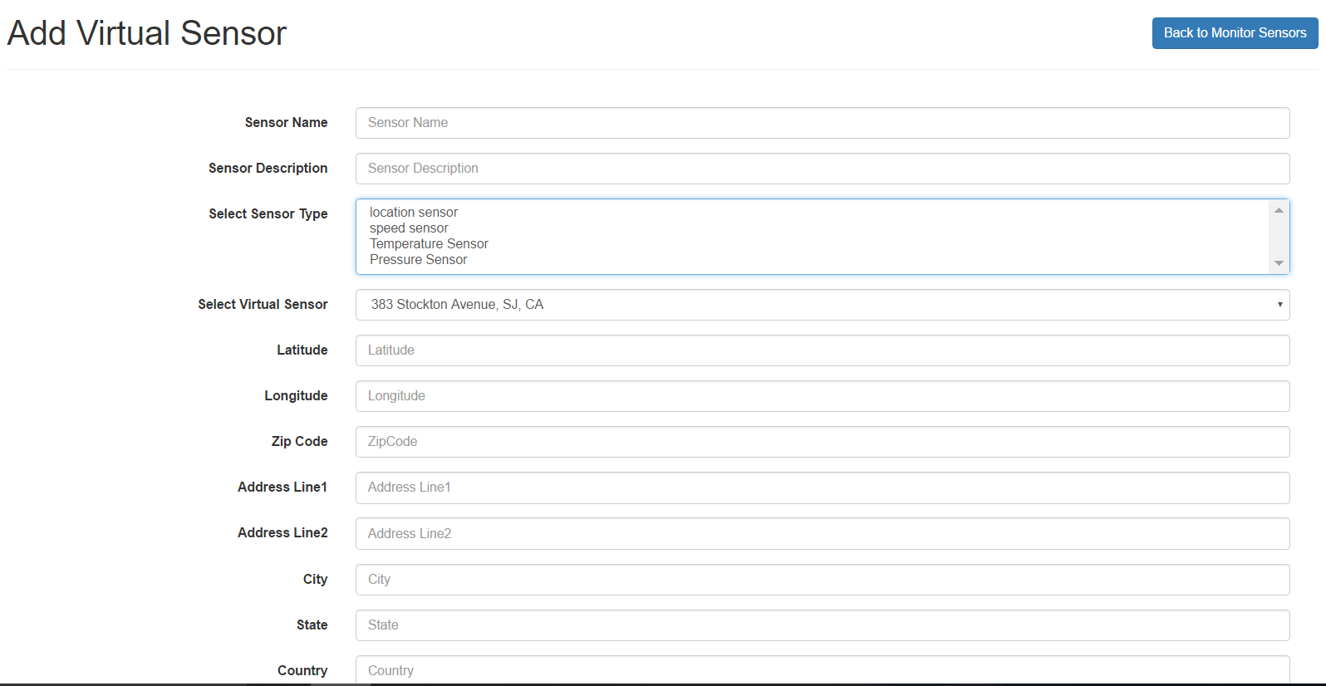
Add Virtual Sensors

Slide 8
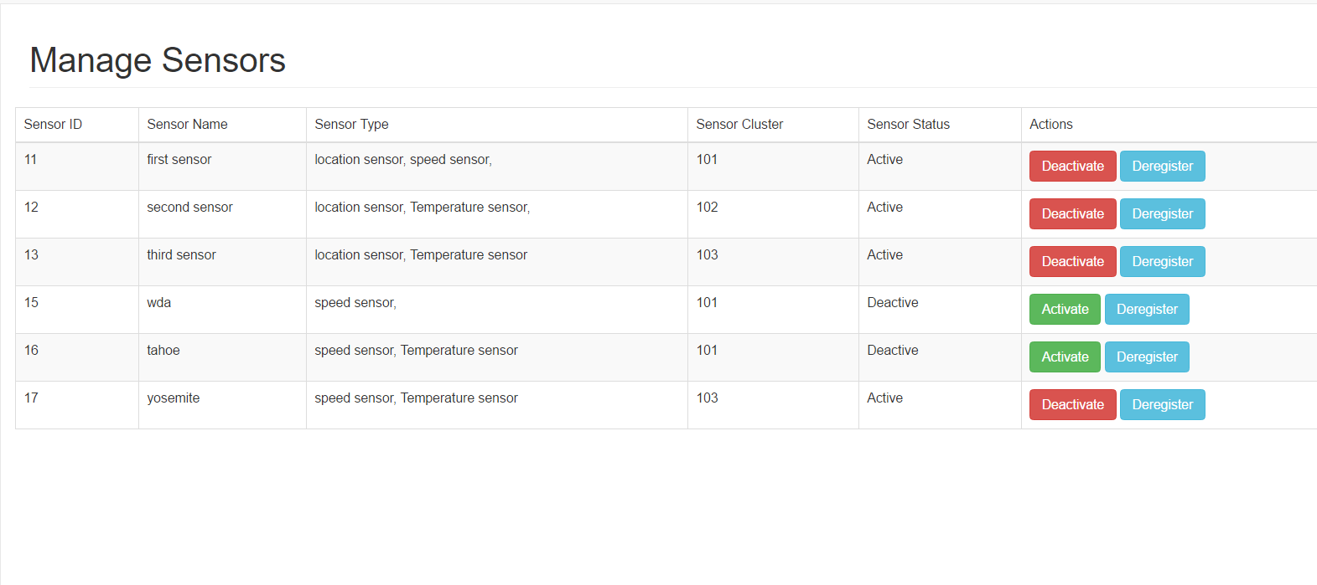
Sensor Management

Slide 9
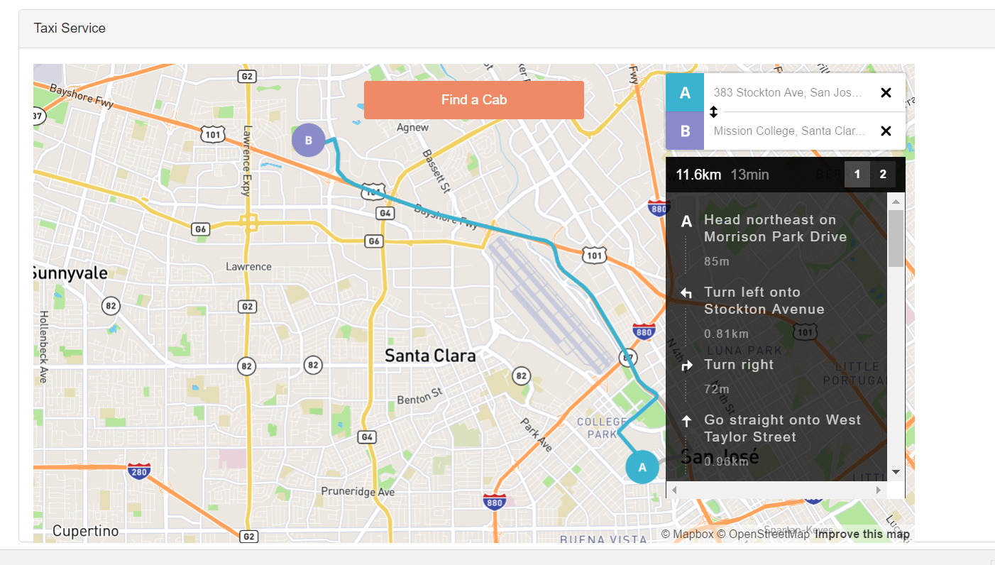
End User Service
End user mentions his source and destination

Slide 10
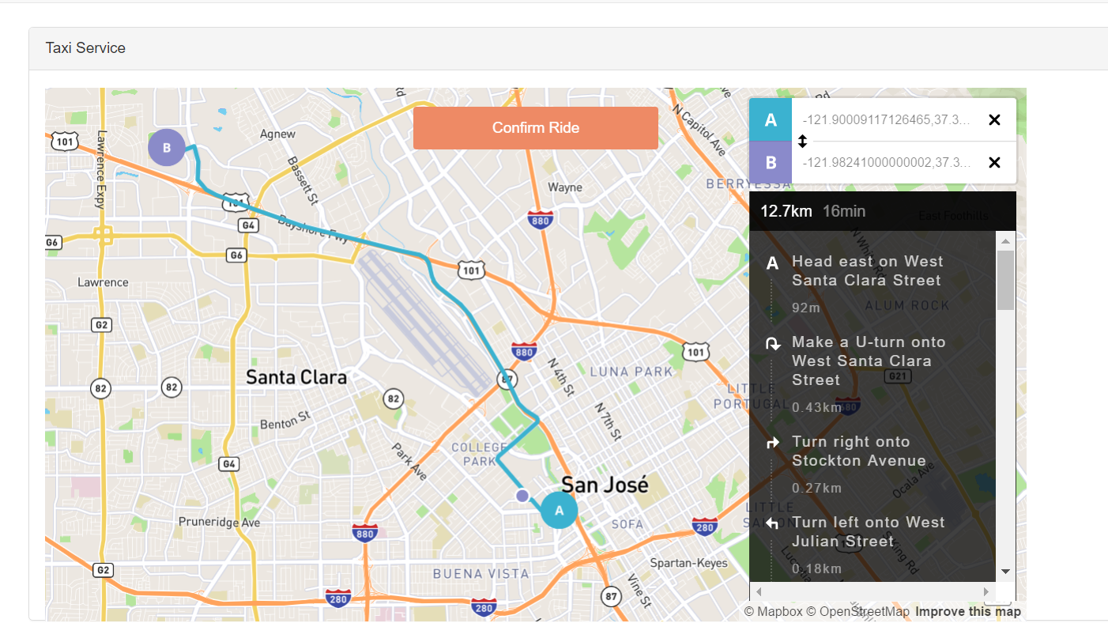
Continued..
End user then finds a cab based on sensor data where A is Cab Location , purple marker is the customer location and B is the destination

Slide 11
Service Use Cases: Sensor Provider
Sensor provider owns the sensor services
Bill generated based on the active time of sensors
Sensor Provider can add, activate/deactivate and deregister sensors.

Slide 12
Service Use Cases: Sensor Consumer
Sensor consumer use the sensor data provided by the sensor provider.
Sensor consumer can monitor his vehicles.
Sensor consumer can deactivate his vehicles but cannot add a sensor

Slide 13
Service Use cases: End User
End user is provided with the service to find nearby taxis based on the realtime sensor data
End user can check his Trip History along with the Billing
End user can check his Driving Safety Score

Slide 14
Mobile Cloud Infrastructure Data Repository
Amazon Relational Database Service.
MySQL DB instance.
Why Amazon RDS?
Ease of use.
Scalability.
Available and Durable.

Slide 15
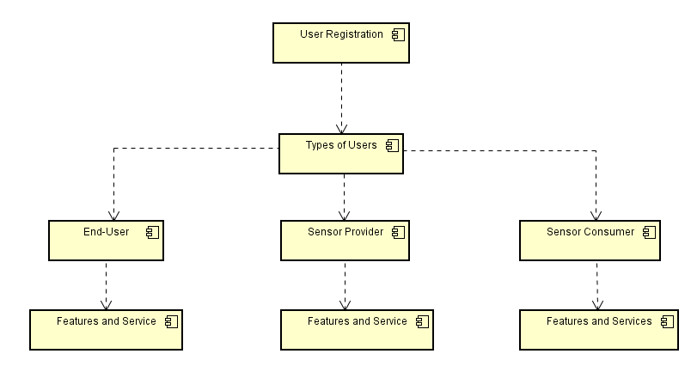
Multitenancy
Multi-tenant application: It isolates different users on the same platform.

Slide 16
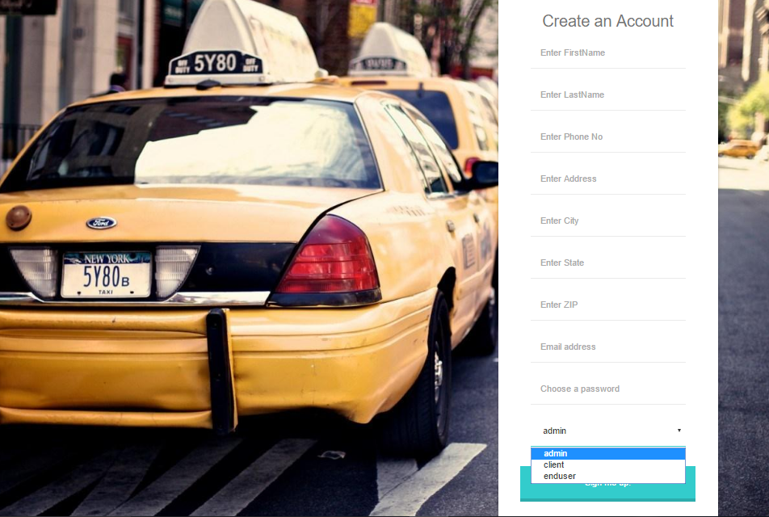
Registration of different tenants with the aid of user type in Sign Up screen.

Slide 17
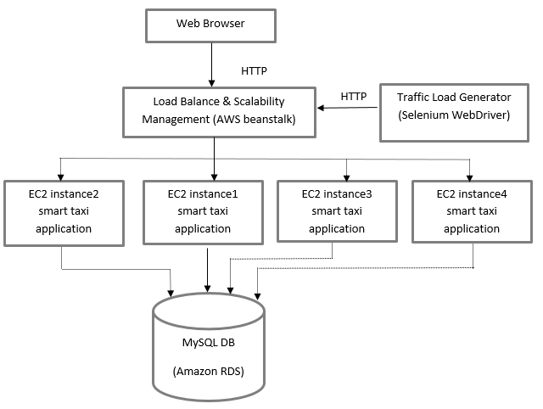
Load Balance, Scalability Management and Traffic Load Generation

Slide 18
Continued
Elastic Beanstalk is a service offered from Amazon Web Services for deploying applications.
Auto Scaling deals with traffic changes by automatically increasing or decreasing the EC2 instances.
Load Balancer balances the network load by distributing traffic which increases resource utilization.

Slide 19
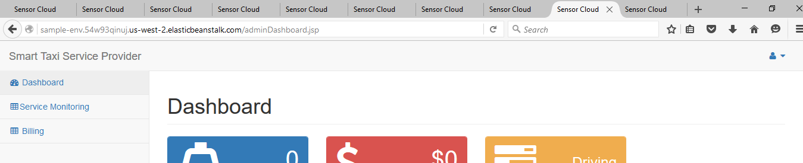
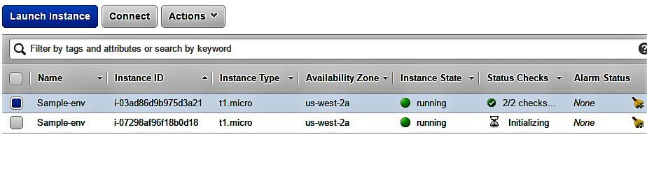
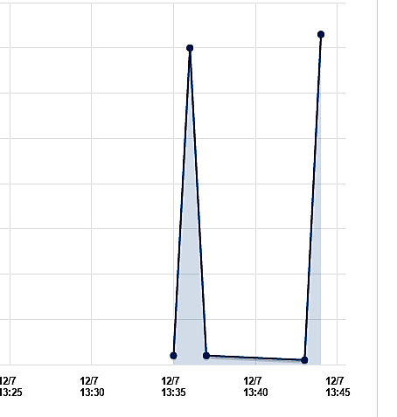
Traffic Load Generation is achieved using Selenium-WebDriver.
Auto Scaling of instances when the request count reaches threshold value.

Slide 20
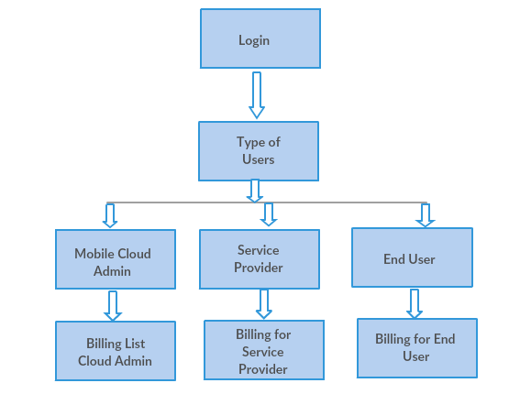
Billing for Sensing and Data Services

Slide 21
Billing - Mobile Sensor Cloud Admin
Mobile Sensor Cloud Admin provides and allocates the sensors to the Service Provider.
Cloud Admin, monitor the sensors and can also activate, deactivate or de-register the sensors.
Mobile Sensor Cloud Admin has the billing list of all the sensors allocated to all the Sensor Service Provider.
Billing calculation: (Sensor de-activated time-Sensor creation time)* cost.

Slide 22
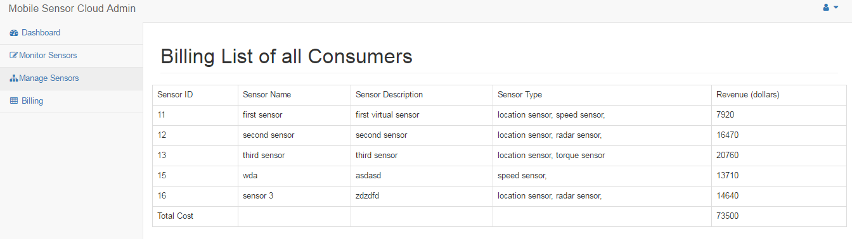
Billing - Mobile Sensor Cloud Admin

Slide 23
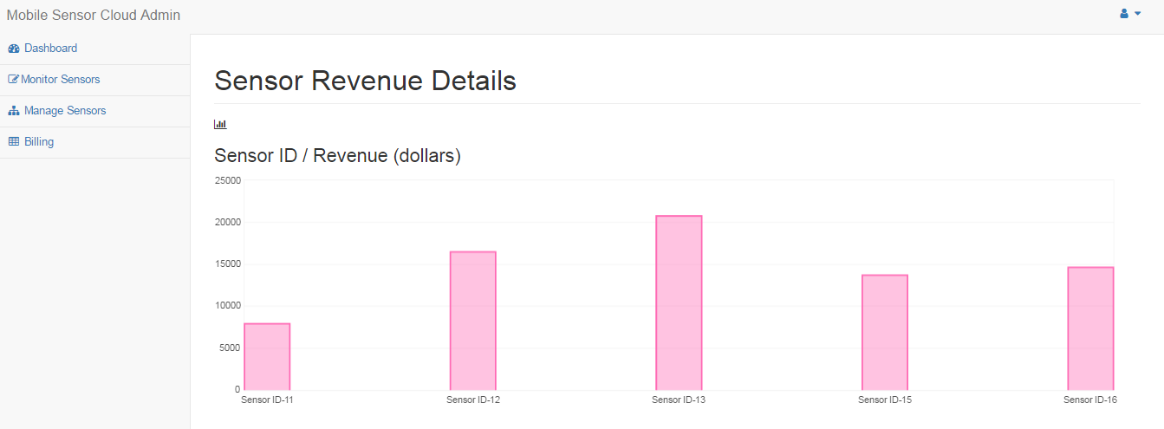
Analytics For Mobile Sensor Cloud Admin

Slide 24
Billing - Service Provider
The billing for the sensor service provider is calculated based on the number of sensors allocated to the particular provider.
Timestamp of the sensor activation and deactivation is noted.
Billing is calculated based on the uptime of the sensor based on the activation and deactivation of the sensors.

Slide 25
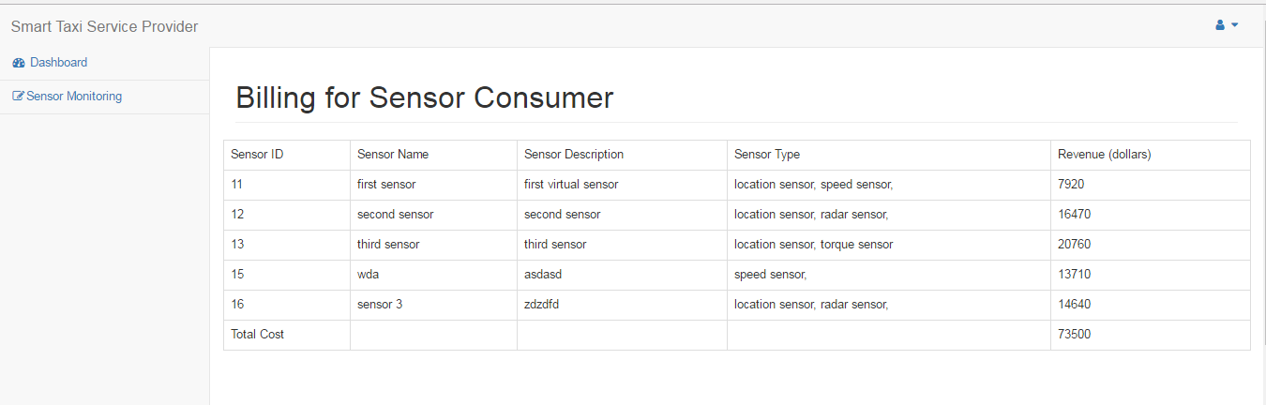
Billing - Service Provider

Slide 26
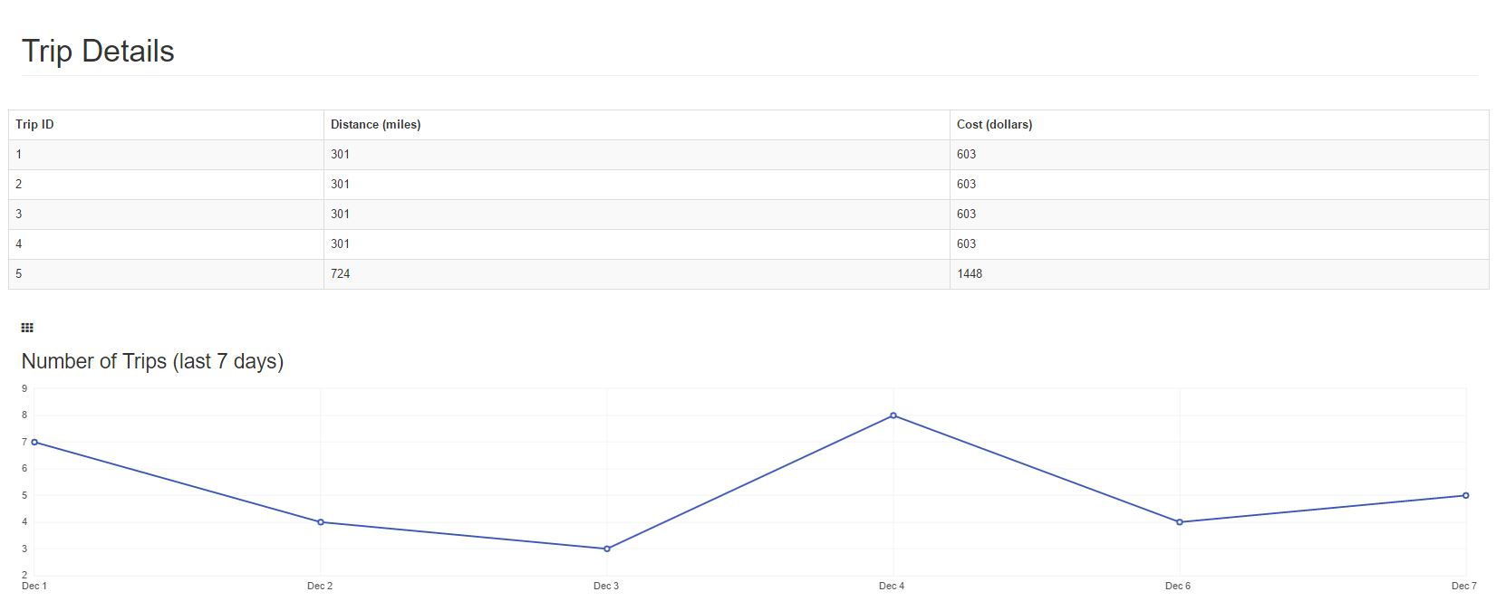
Analytics For Service Provider

Slide 27
Billing - End User
End user is the one who receives the service from the service provider.
End user provides the pick-up and drop-off location.
The billing for the end user is calculated based on the distance between the pick-up and drop-off location.
The billing is also provided with the trip history of his previous rides.

Slide 28
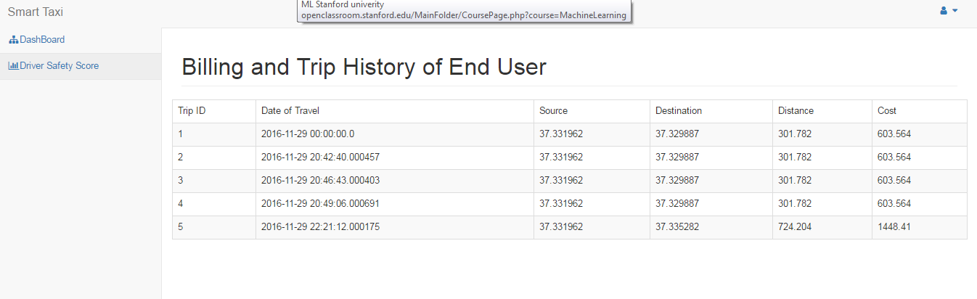
Billing - End User

Slide 29
Technologies Used in our project:
Database:
•Amazon Relational Database Service
•MySQL Cloud Technology:
Amazon EC2, AWS BeanStalk
Real Time Data Mapping:
•Mapbox for customized map
•PubNub for realtime data streaming
Front-end Technologies Used:
•JavaScript
•jQuery
•Bootstrap for simple styling

Slide 30
Driving Quality Analysis
To quantify the Driving Quality, driver safety score is computed using the following 4 parameters. Percentage signifies how each of the parameters impact the final score.
Overspeed (40%)
Distraction instants when driving (40%)
Sudden Acceleration (10%)
Sudden Braking (10%)

Slide 31
Driving Quality Analysis Algorithm
Overspeed (40%)
Avg Overspeed < 5 mph => 40 points
5 mph < Avg Overspeed < 8mph => 30 points
8 mph < Avg Overspeed < 12 mph => 15 points
12mph < Avg Overspeed => 0 points
Distraction instants when driving (40%)
Sudden Acceleration (10%)
Sudden Braking (10%)
Ideally, the standard values for this computation need to be derived from a large dataset of safe driving behavior.

Slide 32
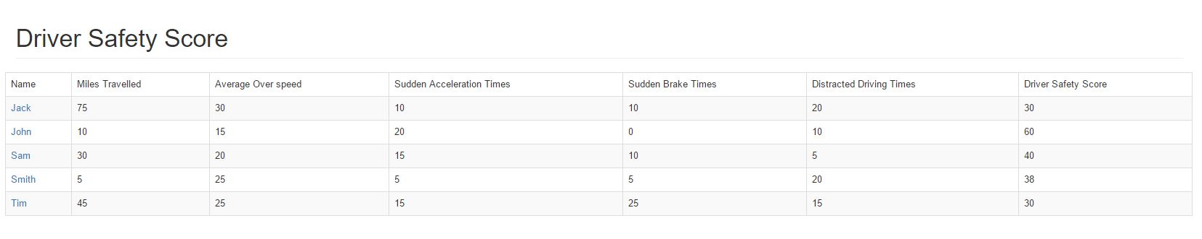
Driving Quality Analysis
The screenshot below shows driver safety score calculated for each user making a trip.

Slide 33
Dashboard & Analytics
Dashboard for each type of user in our application
1. Sensor Provider
2. Sensor Consumer
3. End User
Dashboard fetches critical data from the Database, and displays it in an user friendly manner for analysis.
We have data analytics and graphs to quickly understand and observe the trends.

Slide 34
Sensor Provider
Admin is the one who can add and manage sensor.
Dashboard
Sensors Requiring Service
Total Number of Sensors
Number of Active Sensors
Revenue
Analytics

Slide 35
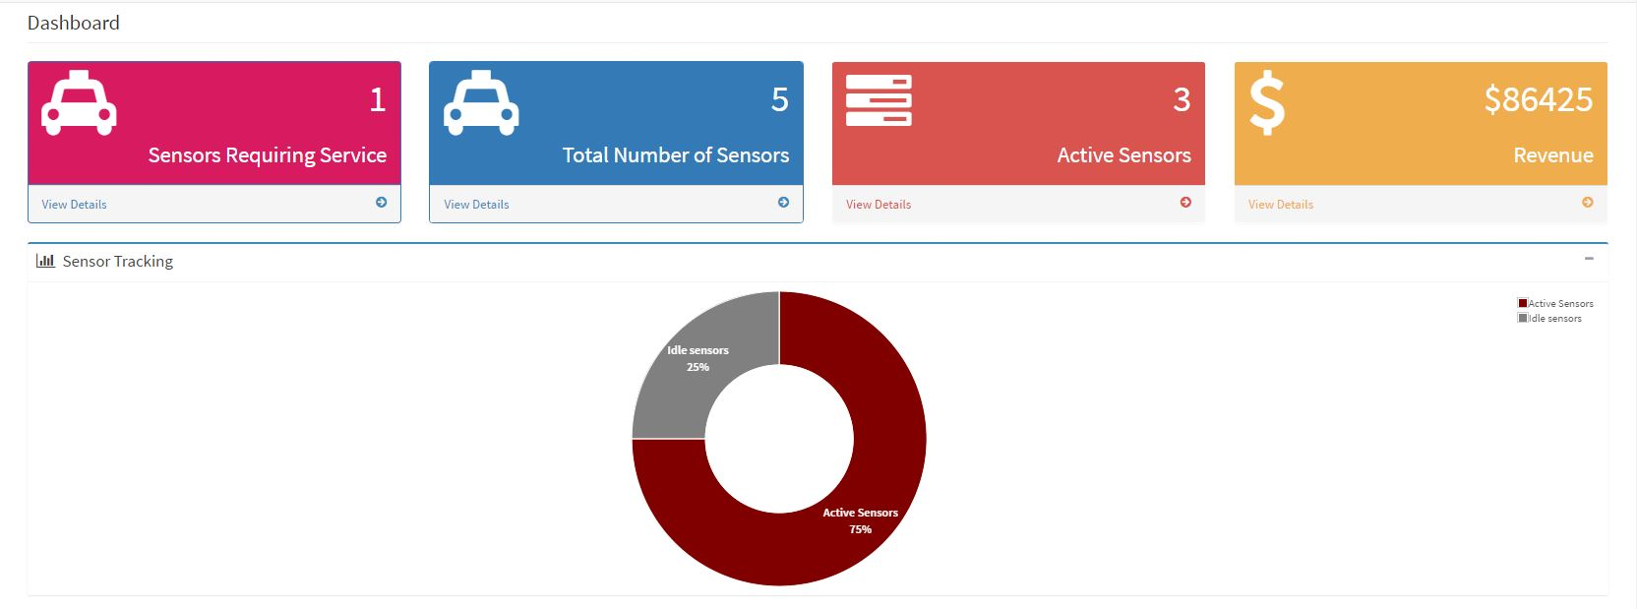
Sensor Provider Dashboard
This is a screenshot of the admin dashboard which shows analytics for sensor details , sensor activity tracking and revenue.

Slide 36
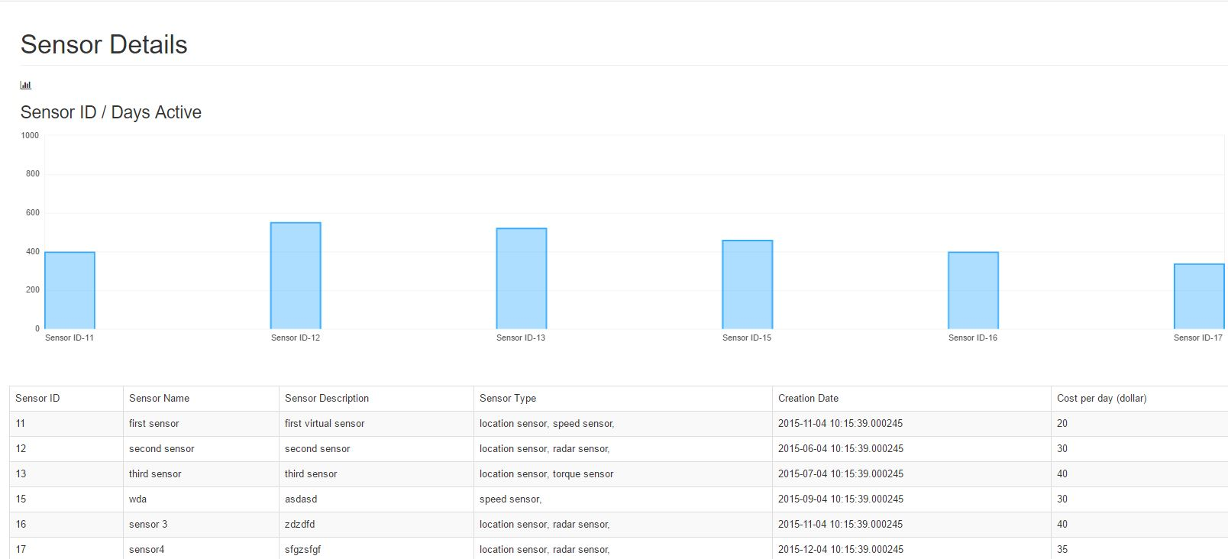
Sensor Provider – Analytics for Sensor details
This screenshot shows the number of active sensors and the number of days each sensor was active.
Active Sensor Time = Last Updated TimeStamp – Creation date TimeStamp

Slide 37
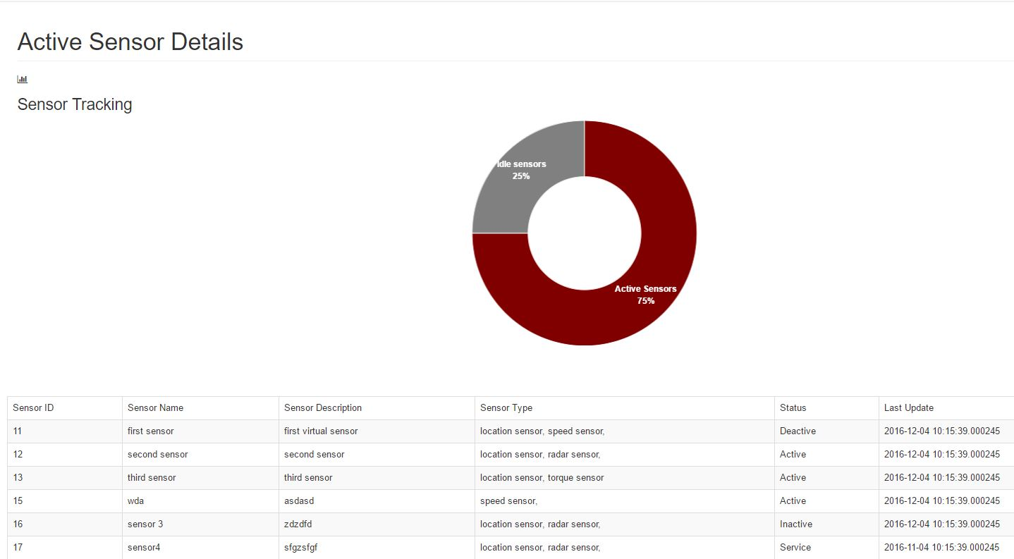
Sensor Provider –Analytics for Active sensors
Admin can track the sensor activity as shown in the screenshot.
The screenshot shows details of registered mobile sensors such as sensor id , name , status, type and last updated timestamp.

Slide 38
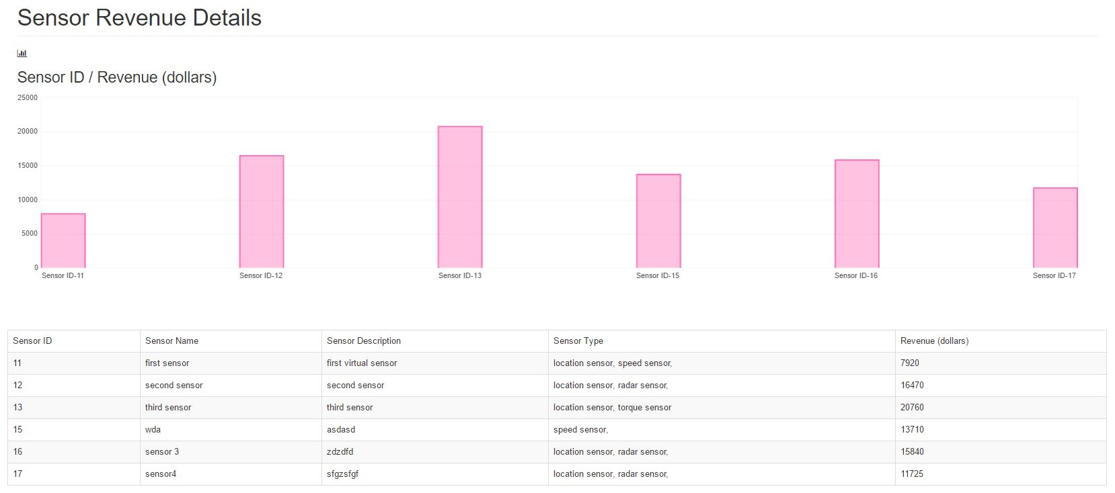
Sensor Provider -Analytics for Revenue
The graph fetches sensor revenue details for each sensor in real time.
This table has details on the revenue generated by each sensor type

Slide 39
Sensor Consumer – (Client who can monitor and de-register sensors added by admin)
Dashboard
Trip Details
Revenue
Driving Quality Analysis
Analytics for Revenue and Trip trends

Slide 40
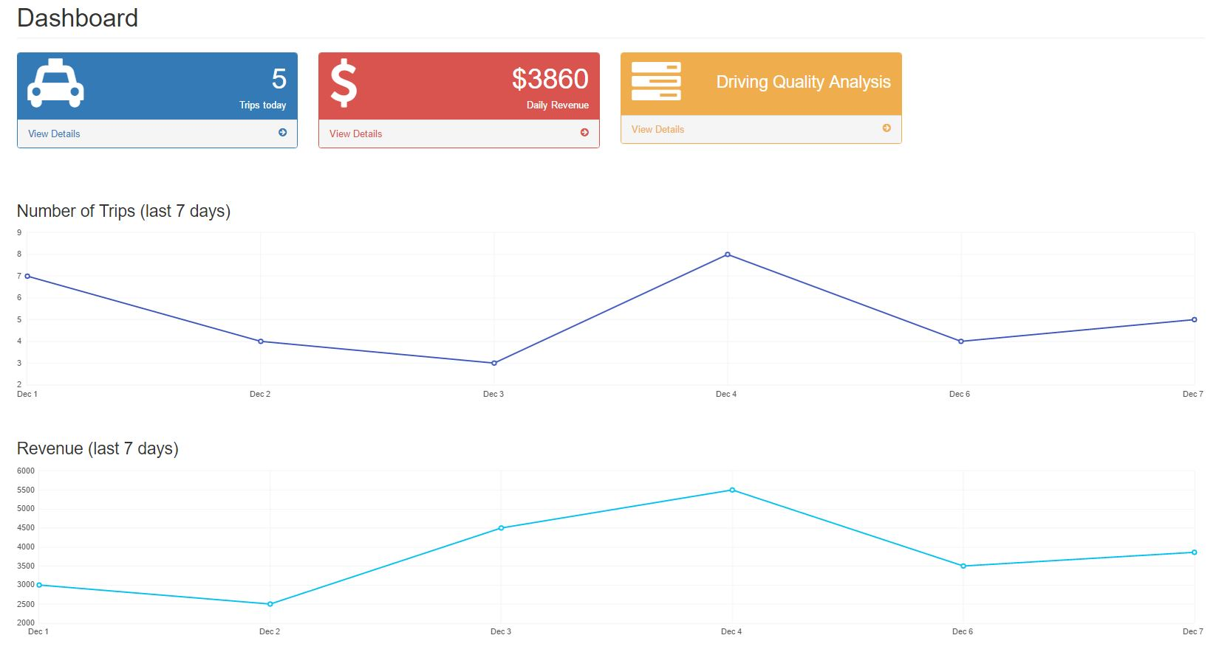
Sensor Consumer
Sensor consumer or client gets sensor as a service from the admin and also provides smart taxi service to the end user.
The screenshot shows the dashboard for sensor consumer.

Slide 41
Sensor Consumer-Analytics for Trip details
The screenshot shows the total number of trips and the distance travelled for each trip along with the trip id .

Slide 42
Thank You

